Slide 1
ELECTRIC VEHICLE CHARGING MONITORING SYSTEM USING BLOCK CHAIN
HARINI C 211519106050
DIVYA B 211519106036
INFANT RAINA P 211519106055
PROJECT GUIDE:
Mr. Arul Kumar

Slide 2
OBJECTIVE/AIM:
Along with the rapid growth of the smart grid and the rise of the Internet of Things and blockchain, the combination of the three has become one of the development directions of the future power industry. The potential of Blockchain technology has been noticed by varies industries. It is reasonable to hypothesize that the energy industry, especially smart energy, can also take advantage of introducing blockchain-based systems, to self-regulate and manage the contractual information and transactions.
Usually when the EV are being charged, the owner details and transaction details are not monitored and authenticated. The main aim of our project is to register, authenticate, collect transaction details and store it as encrypted data in blockchain using Secure Hash Alogorithm.

Slide 3
INTRODUCTION:
Blockchain is a distributed ledger, or database, shared across a public or private computing network.
Every piece of information is mathematically encrypted and added as a new “block” to the chain of historical records; validated by multiple consensus protocols before being added to the ledger. Blockchain can also be programmed with smart contracts - a set of conditions recorded on the block-chain, to trigger transactions when the conditions are met. Blockchain technology has multiple potential applications in the energy sector from tracking of electrons to processing of payments. Given that the benefit of increased adoption of Electric Vehicles (EV) will be compounded if the source of electricity used for charging is clean, the application of blockchain in the sector becomes even more crucial.

Slide 4
EXISTING SYSTEM:
Our investigation proposal is to bring computer science work on software development, Web 2.0, geographic information systems, mobile computation and wireless communication, to a new growing area of Smart Grids (SG) and EV (Electric Vehicle). Due to the increasing complexity and diversity of options, users in Electrical Markets (EM), when performing an EV charging process, will need the help from software application, mainly to mobile devices. So our proposals, presented in this paper, are the conception and the creation of a mobile application and surrounding system, to help users on EV charging or discharging process, and also on EM participation

Slide 5
PROPOSED SYSTEM:
The proposed model is to build a model for electric vehicle Charging and Monitoring system. Currently, Indian roads are dominated by conventional vehicles and have approximately 0.4 million electric two-wheelers and a few thousand electric cars . So a proper system is required to monitor the charging, transactions and the user details.
Firstly the EV is registered, after which when it reaches the station it is authenticated. Then the Transactions are done, later on it is updated and verified on Block chain.
The Algorithm used here is SECUREHASH ALGORITHM(cryptography technique) Every piece of data produces a unique hash that is thoroughly non-duplicate by any other piece of data.

Slide 6
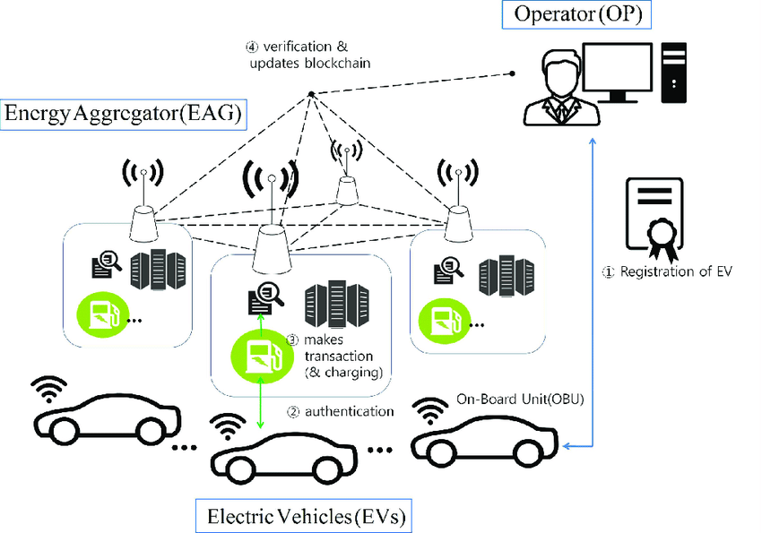
BLOCK DIAGRAM:

Slide 7
METHODOLOGY:
The increase in development of electric vehicle(EV) will have a strong impact on the power distribution grid if adequate care is not taken on the high power demand required for charging EV. Consequently, there is need to create a platform to enable charging point operators to effectively manage the EV user’s charging requests and ensure that there charging needs are satisfied while not exceeding the distribution grid capacity. This work proposes a smart EV charging infrastructure based on a blockchain platform.
With the charging demand (kWh) and maximum duration of the charging event provided by the EV user, the EV load flexibility is determined and utilized through smart charging to achieve a stable grid. EV owners and charging stations are linked through the platform thereby reducing the actors in EV charging ecosystem from six to four. Flexibility (power and time) in charging of EV is traded within the blockchain platform. By this, additional investors will be attracted into the business of EV charging station and through flexible offers, EV loads are shifted from the peak load hours.

Slide 8
Environmental Requirements:
Software Requirements:
Operating System : Windows 10 or later
Tool : JAVA, Embedded C, Arduino IDE
Hardware requirements:
Electrical Vehicle Supply Equipment, OCPP, EV Charging Point, Local Controller, Battery, Power Conversion System, Software Stacks.

Slide 9
REFERENCES:
Z. Lv, L. Qiao, K. Cai, and Q. Wang, “Big data analysis technology for electric vehicle networks in smart cities,” IEEE Transactions on Intelligent Transportation Systems, vol. 22, no. 3, pp. 2021.
Aashish Joshi, K M Vishall Somaiya, Arni Tharakaram Hariram, Mubashir Hussain, "Electric Vehicle Charging Station", International Journal of Scientific Research in Science, Engineering and Technology (IJSRSET), Online ISSN : 2394-4099, Print ISSN : 2395-1990, Volume 8 Issue 4, pp. 122-128, July-August 2022.
2021 IEEE 2nd International Conference On Electrical Power and Energy Systems (ICEPES)

